Slide 1

Intelligent Factory
2019/2020
Agents and Distributed Artificial Intelligence
Group 21:
Andrea Díaz Henry C. - up201901577@fe.up.pt
Helena Montenegro - up201604184@fe.up.pt
Juliana Marques - up201605568@fe.up.pt

Slide 2
Description of data analysis problem
In the first part of the project we developed a factory which had machines and received orders with tasks that needed to be fulfilled by the machines. The goal was to allocate machines to do the orders while minimizing the time needed to fulfil each order.
The orders offered credits to the machines that did each of its tasks. When an order was not satisfied with the finish time proposed by the machines that wanted to do the task, it would enter a process of negotiation by increasing the credits given, in order to obtain better times.
The purpose of the second part of the project is to study the number of credits that the orders need to increase during the negotiation process so that the machines execute the task in a satisfying time, considering the independent variables that are accessible to the orders. Therefore we will answer the following questions:
If the order gives more credits to the machine, will it execute the task at the desired time?
How does a machine’s execution time improve when the order increases the credits given during the negotiation process?
1

Slide 3
Experiments
Experiment 1 - Classification
If the order gives more credits to the machine, will it execute the task at the desired time?
Independent Variables:
initial credits, increased credits, increment in credits,
number of machines competing,
number of orders that machine has fulfilled,
machine’s initial execution time,
order’s desired execution time,
desired improvement in execution time.
Dependent Variable:
whether the machine accepts the proposal.
Models:
Decision Tree,
Neural Network,
K-Nearest Neighbours.
2

Slide 4
Experiments
Experiment 2 - Regression
How does a machine’s execution time improve when the order increases the credits given during the negotiation process?
Independent Variables:
initial credits, increased credits, increment in credits,
number of machines competing,
number of orders that machine has fulfilled,
machine’s initial execution time
Dependent Variable:
machine’s resulting execution time
Models:
Linear Regression
Neural Network
Decision Tree
3

Slide 5
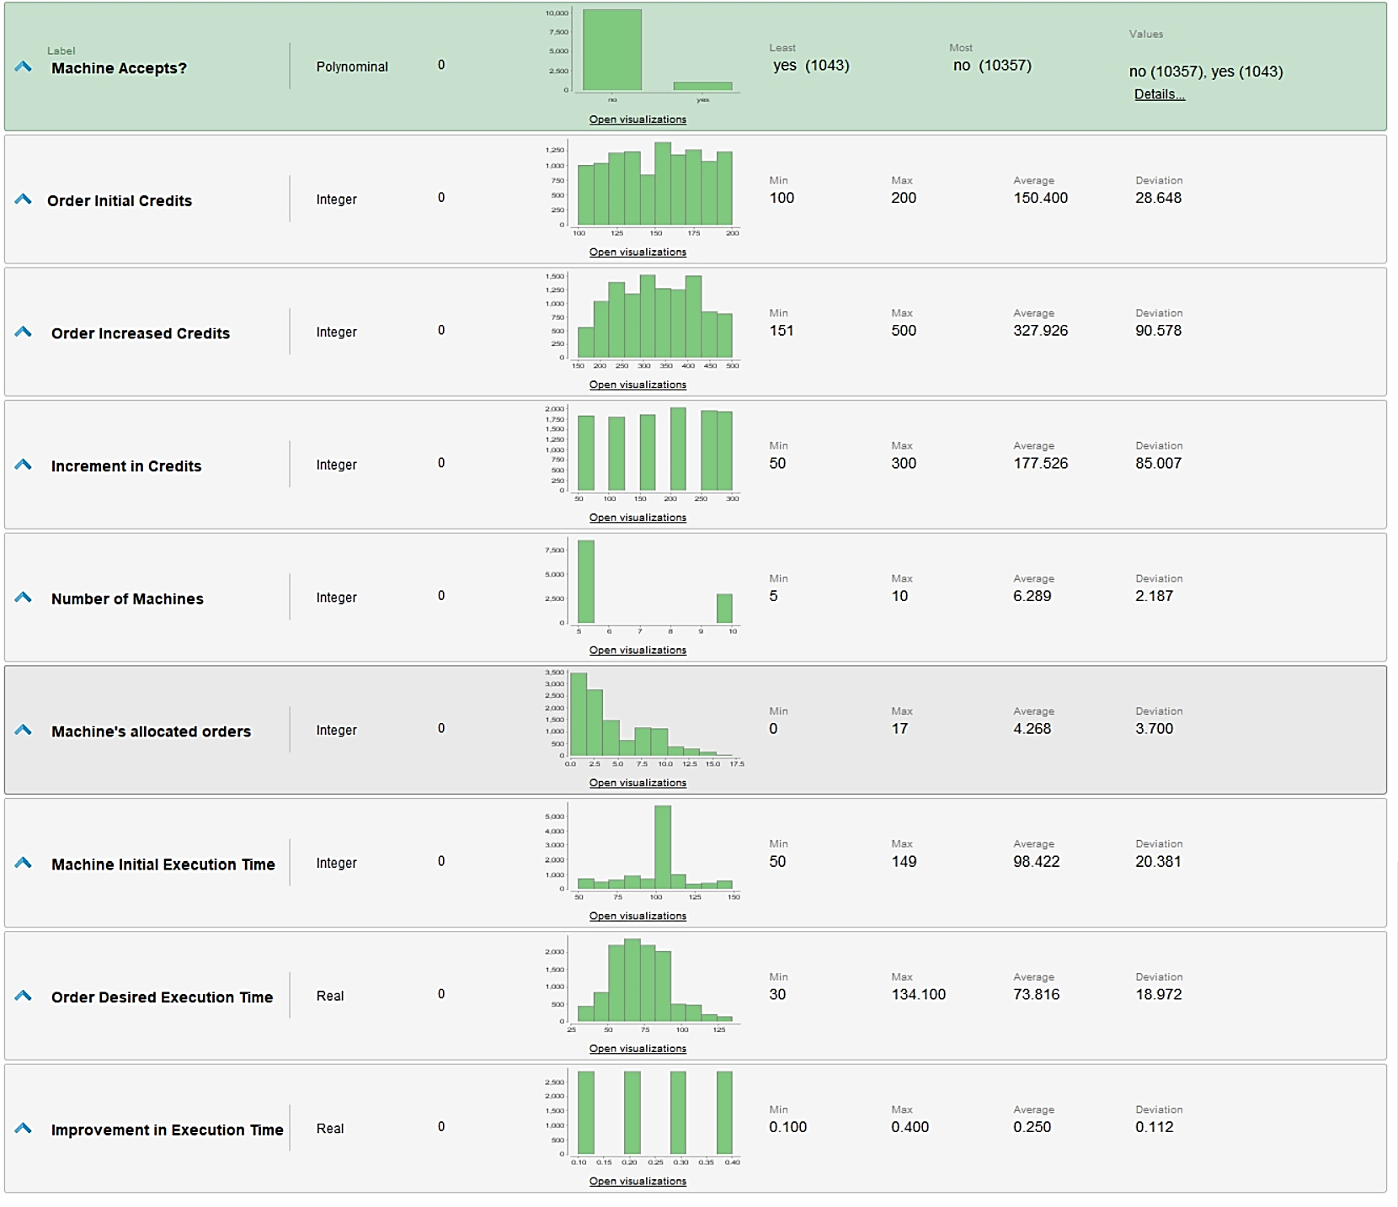
Statistics on collected data
Experiment 1:
For this experiment we used independent variables that are accessible by the order.
A limitation to the data was that we ran the project a little number of times to get the data, since only running one time already gives us thousands of rows of data, depending on the number of existing agents. As such, in order to not overcrowd the data, we only tested with 5 and 10 machines in the system and with a limited number of orders.
In the future, it would be interesting to increase the number of agents and see how the results change in accordance to that.
4

Slide 6
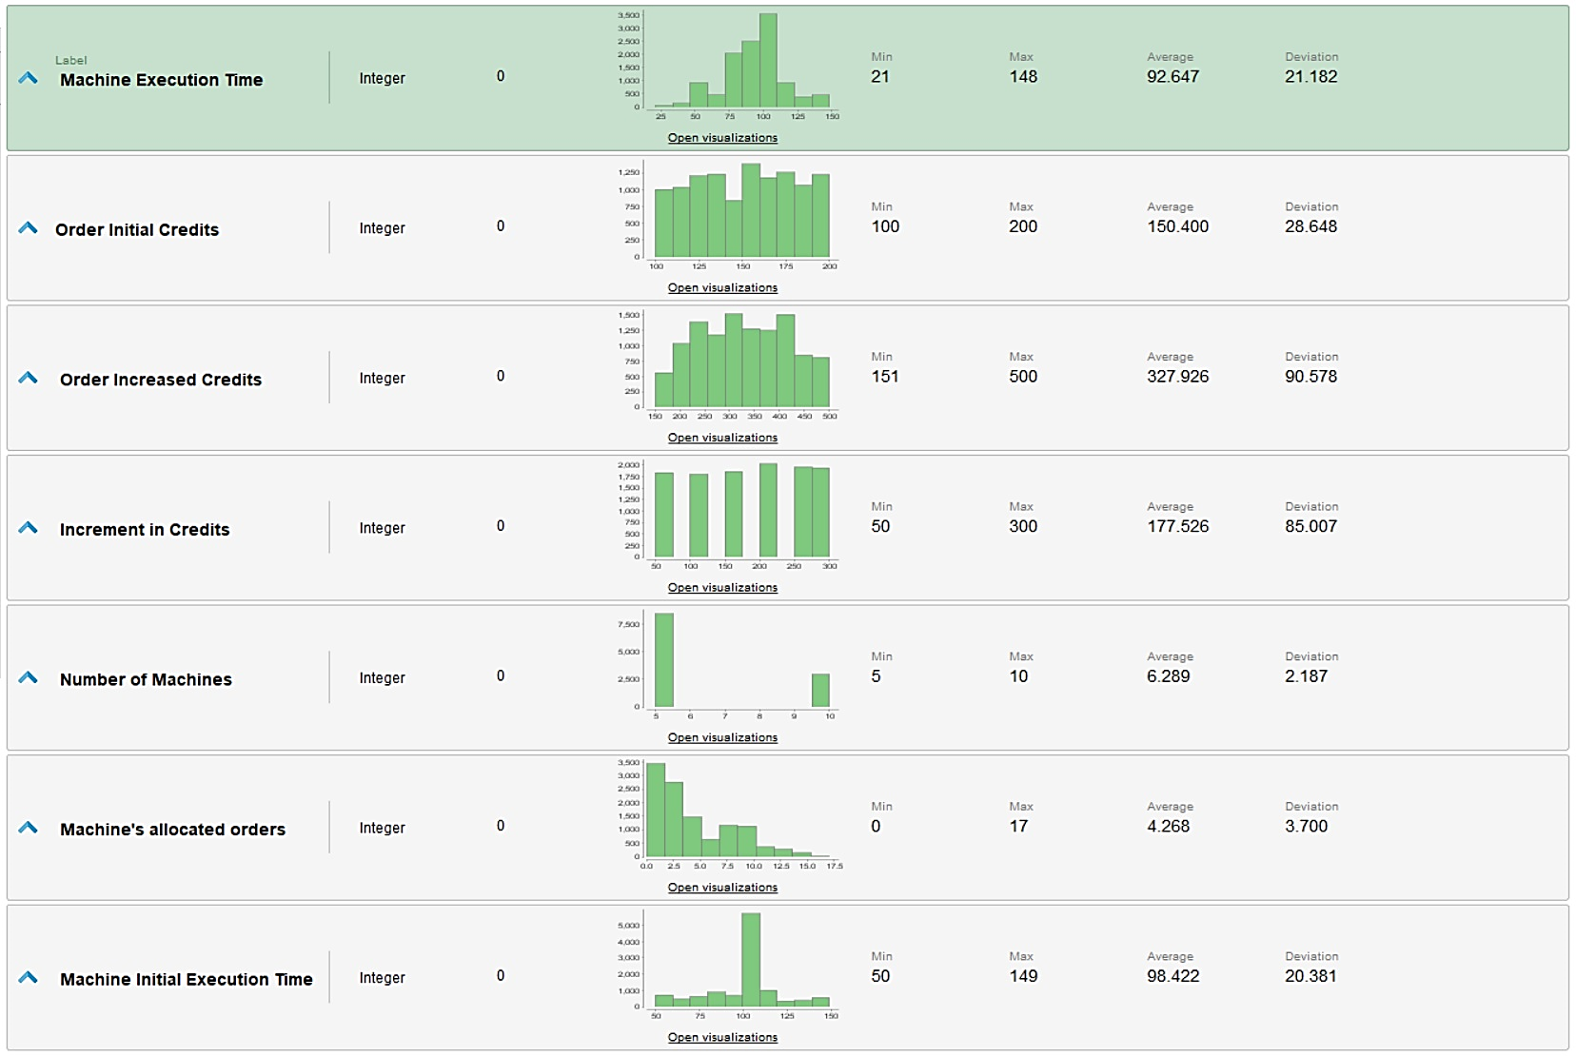
Statistics on collected data
Experiment 2:
This case is similar to the previous slide.
The data used is the same, only the columns available change since there are some, such as the order’s desired credits, that are useless for regression.
The data has the same limitations as expressed in the previous slide.
5

Slide 7
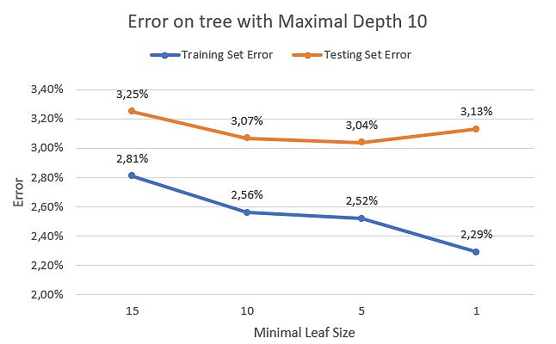
Data analysis with RapidMiner
Experiment 1 - Classification: Decision Tree
We divided our data in a testing set and a training set, with 70% of the data being used in training to obtain a decision tree model, which we tested with two different values for the tree’s maximal depth (5 and 10) and with different minimal leaf sizes, in order to check overfitting.
The resulting errors were very small, around 2-4%, both in the training set and testing set.
This image shows the results of the error that we obtained with a tree that has maximal depth 10.
As the minimal leaf size decreases, we can see that the error on the training set also decreases. Between minimal leaf sizes of 5 and 1, we can see a significant decrease in the error of the training set and an increase in the error on the testing set, which means that there is overfitting for values of minimal leaf size between 1 and 5. However we cannot conclude that there is no overfitting for bigger values of the minimal leaf size.
6

Slide 8
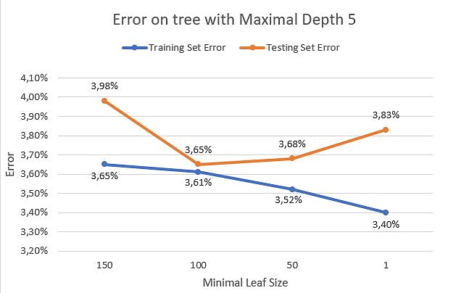
Data analysis with RapidMiner
Experiment 1 - Classification: Decision Tree
With maximal depth of 5, the tree becomes significantly smaller, which means it needs bigger values of minimal leaf size to check for overfitting. Since the tree is smaller, the error is bigger when compared to the error on the tree with maximal depth of 10.
This image shows the results of the error that we obtained with a tree that has maximal depth 5.
Again, as the minimal leaf size decreases, we can see that the error on the training set also decreases. Between minimal leaf sizes of 100 and 1, we can see that the error on the training set continues to decrease while the testing set error increases, which means that when the values for minimal leaf size are reduced to 100, there is overfitting.
In similarity to the previous slide, we cannot conclude that there is no overfitting when the minimal leaf size is bigger.
7

Slide 9
Data analysis with RapidMiner
Experiment 1 - Classification: Decision Tree
We can conclude that the error obtained using the decision tree model on the data is very small, in between 2-4%, which could mean that the decision tree model is appropriate for the data.
When comparing both the trees used, we see that the tree with lower maximal depth size obtained errors slightly bigger. It also needs higher values for the minimal leaf size to see changes in the tree and in the error. As such, we can conclude that the model with maximal depth 10 presented better results for the data.
From all the decision tree models, the most appropriate one has as maximal depth 10 and minimal leaf size 10, which presented the most accurate results when applied to the testing set (its error is only 3,04%), without seeming to be overfitted.
8

Slide 10
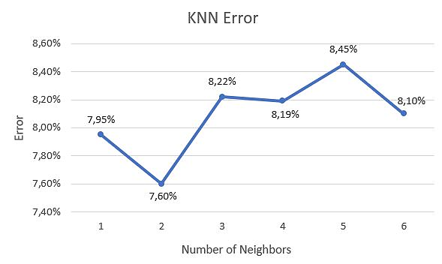
Data analysis with RapidMiner
Experiment 1 - Classification: K-Nearest Neighbours
We applied the K-Nearest Neighbour to our data, to check if this model is appropriate.
We tested with K in the interval [1, 6] and obtained errors between 7,6% and 8,45%, as shown in the graph. We also observed that this behaviour holds up for bigger numbers of neighbours.
This algorithm with high numbers of neighbours would be useless because of the difference in quantity of the answers (yes and no) - we verified in the statistics that there are significantly more answers “no” than “yes”. This means that for a sufficiently high number of neighbours, all the “yes” values might be classified as “no”, which would mean that error = #no / #yes, which would be around 10%.
Even though the error might not look very big, a model where every machine refuses proposals would be useless to an order.
9

Slide 11
Data analysis with RapidMiner
Experiment 1 - Classification: K-Nearest Neighbours
We thought of some hypothesis that would explain why the model presents this oscillating behaviour:
Data layout - the way the data is distributed in the system might make the model’s results become better and worse repeatedly. An example of a layout that could explain this behaviour is the one shown in the picture. In this case, by changing the number of neighbours, we would obtain different classifications for the same node, which means that the error would increase and decrease over and over again.
10

Slide 12
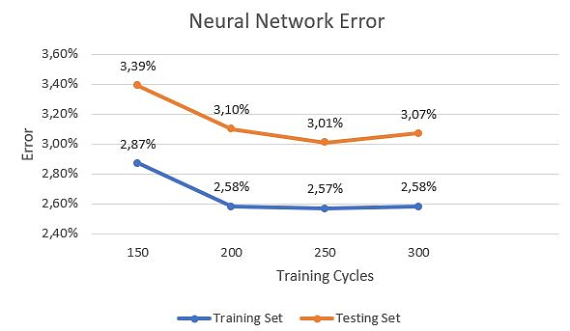
Data analysis with RapidMiner
Experiment 1 - Classification: Neural Network
By applying the Neural Network model to our data, we obtained errors for the testing set around 2-3%. We decided to change the number of training cycles and see how the error changed.
As we can see in the image, as the training cycles increase, the error decreases. However, between 250 and 300 training cycles, we can see that the error on the testing set increases. This means that around these values for the training cycles, the model becomes overfitted to the data.
In general the results are satisfying. For this model, we would choose a number of training cycles between 200 and 250, in which the model obtains a good error margin without seeming overfitted.
11

Slide 13
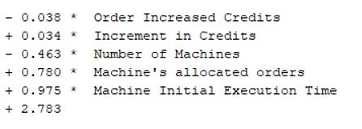
Data analysis with RapidMiner
Experiment 2 - Regression: Linear Regression
We applied linear regression to our regression data set. We also divided our data in training and testing sets, with a distribution of 70 - 30, respectively. We obtained the model in the image.
Since the root relative squared error belongs to the interval ]0,1[, we can conclude that this model is useful, as the error is lower than the one obtained with trivial prediction.
We can also see that there is a big correlation between the attributes used for prediction and the attribute we wanted to obtain (machine’s execution time).
Root Mean Squared Error: 7,025 +- 0,0
Root Relative Squared Error: 0,330
Correlation: 0,994
12

Slide 14
Data analysis with RapidMiner
Experiment 2 - Regression: Neural Network
We applied the neural network model to our regression data set, with a training set of 70% of the data and the testing set with the remaining 30%. We tried with 200 training cycles. We also tried changing this number between 150 and 300 but the resulting error was around the same value.
Root Mean Squared Error: 5,369 +- 0,0
Root Relative Squared Error: 0,252
Correlation: 0,969
Since the root relative squared error belongs to the interval ]0,1[, we can conclude that this model is useful, as the error is lower than the one obtained with trivial prediction.
There is a big correlation between the attributes used for prediction and the attribute we wanted to obtain (machine’s execution time).
Compared to linear regression, this model obtained a lower error, which might mean that it’s better.
13

Slide 15
Data analysis with RapidMiner
Experiment 2 - Regression: Decision Tree
We applied the decision tree model to our regression data set, with a training set of 70% of the data and the testing set with the remaining 30%. We tried the decision tree model that gave us the best results in classification: maximal depth 10 and minimal leaf size 10.
Root Mean Squared Error: 4,323 +- 0,0
Root Relative Squared Error: 0,203
Correlation: 0,979
Since the root relative squared error belongs to the interval ]0,1[, we can conclude that this model is useful, as the error is lower than the one obtained with trivial prediction.
There is a big correlation between the attributes used for prediction and the attribute we wanted to obtain (machine’s execution time).
The error obtained using this set is even better than the error obtained using a neural network, which might mean that this model is better suited for regression in this data set.
14

Slide 16
Conclusions
Experiment 1 - Classification:
There were two models that obtained similar results in terms of accuracy: Decision Tree, with maximal depth of 10 and minimal leaf size of 10 (error of 3,07%) and Neural Network, with 200 training cycles (error of 3,10%).
The results were so similar that it’s not possible to say which one is the best. With the K-Nearest Neighbour algorithm, we obtained unexpected results, with higher errors, which makes this model the worst of the ones studied.
Experiment 2 - Regression:
All the models applied gave us satisfying results, with low errors. Of the three used, the Decision Tree model seemed slightly better than the rest, but the difference is not so significant that we can conclude that it’s the best.
In general:
We obtained satisfying results, with low errors. The only model that presented unexpected results was the K-Nearest Neighbours when applied to classification.
There were some limitations in terms of data, such as the low variation in number of machines and orders, which could influence the results obtained. In the future, we could consider increasing our data sets by exploring the different values that many variables can take and see how different the results are when compared with this limited dataset.
15

Slide 17
Additional Information
Intelligent Factory

Slide 18
RapidMiner Processes
In every process we used the operator Split Validation, with stratified sampling so that the class distribution in the subsets is the same as the whole data set. We used 70% of the data for the training set and 30% for the testing set.
For classification we used the operators Decision Tree, k-NN and Neural Net. We applied the models obtained with the training set to both the training set and the testing set (except the k-NN operator which was only applied to the testing set) and obtained the resulting accuracy / classification error, by using the operator Performance (Classification). The reason we applied the model also to the training set was to see how the resulting error would change when applying the same model with different variables.
For regression we used the operators Linear Regression, Decision Tree and Neural Net. We applied this to both the training set and the testing set and obtained the resulting accuracy / classification error, by using the operator Performance (Regression).
16

Slide 19
Other Comments
To run the processes, there might be a need to either organize the folders according to the defined paths or to change the path where each process obtains the data.
The folders in the paths are organized in this manner:
classification
processes
results
data
regression
processes
results
The processes are saved inside classification/processes and regression/processes.
The data is saved inside the data folder.
The results after running the processes appear in the results folders.
We only submitted a process for each operator applied, even though we might have used the same process with different variables throughout the project. For example, on the Decision Tree for classification, we changed the variables maximal depth and minimal leaf size, but we only submitted the process with maximal depth 10 and minimal leaf size 10, since all the processes would be the exact same, only with different values for these variables, so we didn’t feel the need to submit all 8 processes.
17

